Slide 1
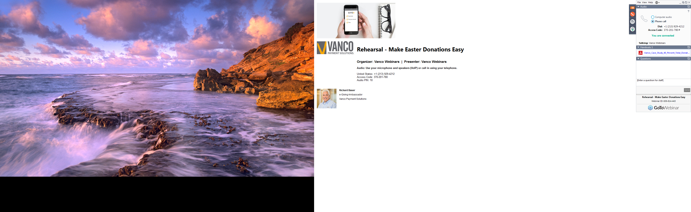
Thank you for joining! We'll be getting started shortly.
In the meantime, please familiarize yourself with the GoToWebinar tools:
1. Please make sure you are connected to audio
(Note: We recommend you select Computer audio)
2. Download handouts here
3. Submit questions throughout the webinar here

Slide 2


Slide 3
Welcome to the Webinar –
We'll be getting started shortly!
Attendees are in
“listen only” mode
Ask questions throughout using the Questions panel in GoToWebinar
We will send you a copy of the slides and the recording

Slide 4
Today’s Agenda
How RevTrak simplifies reconciliation
5 Reports You’ll Meet in RevTrak (…and how they’ll make your job easier!)
  Statement
  Gross Report by Date
  Deposit Report by Account Code
  Finance by Bank
  Settlement Report [for ConnexPoint users]
Additional Helpful Articles and Resources
Next Steps
Notes:
Need to avoid talking about Net Funding options
The monthly statement shows the fees all the deposits that have been made per day that was depsoitied into each deposit account; statement from each bank account
Summary statement that shows ALL deposits for the districts
District overview;
These tools to help them reconcile; talking about common way to reconcile to bank and verify that what they see on statement matches in what they see in their bank and also what they see in RevTrak

Slide 5

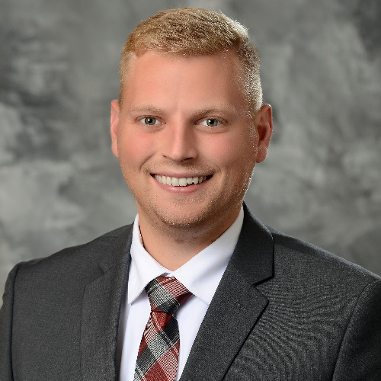


Today’s Presenters:
Francine Clausen
Senior Strategic Client Partner
Krysten Demster
Marketing Manager

Slide 6
[Poll]
When it comes to your Web Store, what challenges are top of mind for you this year?
Notes:
When it comes to your Web Store, what challenges are top of mind for you this year?
Encouraging parents to use the web store and making sure they understand how
Reducing time it takes to reconcile
Getting staff properly trained on using the web store
Accepting a greater % of payments online this year
Other (write in)
_____________
What is your biggest challenge to tackle for back-to-school?
-Handling cash and check payments
-Getting parents to move away from cash and paper forms and getting them online
-Registration
-Preparing for open house
-Preparing for other school events
-Preparing our child aftercare program for fall
-Other [write-in option]

Slide 7
It should NOT take hours to reconcile payments.
These RevTrak tools will help simplify reconciliation.

Slide 8
Statement Reports
These monthly merchant statements show your daily deposit totals, less refunds and debited fees.
Statements are available 3-4 business days after the start of the new month.
For ConnexPoint users, statements can be found under ‘Reports’ in ConnexPoint.
If you are not using ConnexPoint, reports are sent via email.

Slide 9
“We currently have maybe 30% of payments coming through the Web Store – but we’d like to get to at least half of our payments coming through online”
Notes:
When it comes to your Web Store, what challenges are top of mind for you this year?
Encouraging parents to use the web store and making sure they understand how
Reducing time it takes to reconcile
Getting staff properly trained on using the web store
Accepting a greater % of payments online this year
Other (write in)

Slide 10
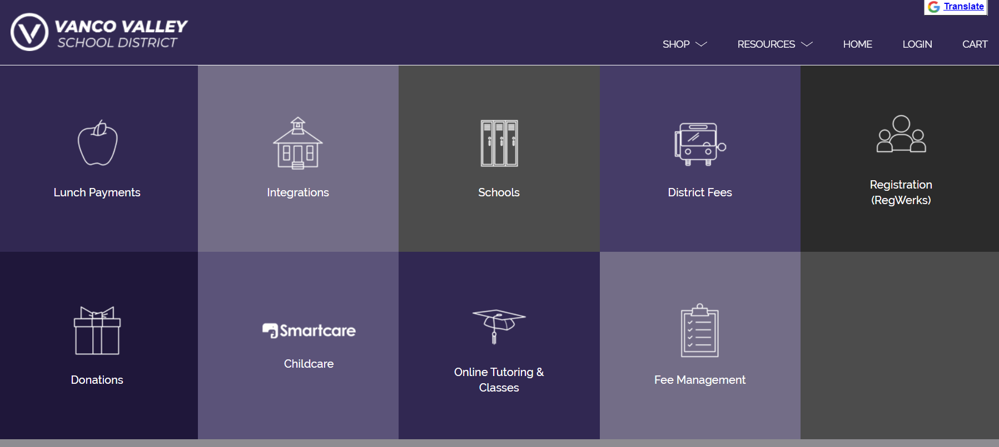
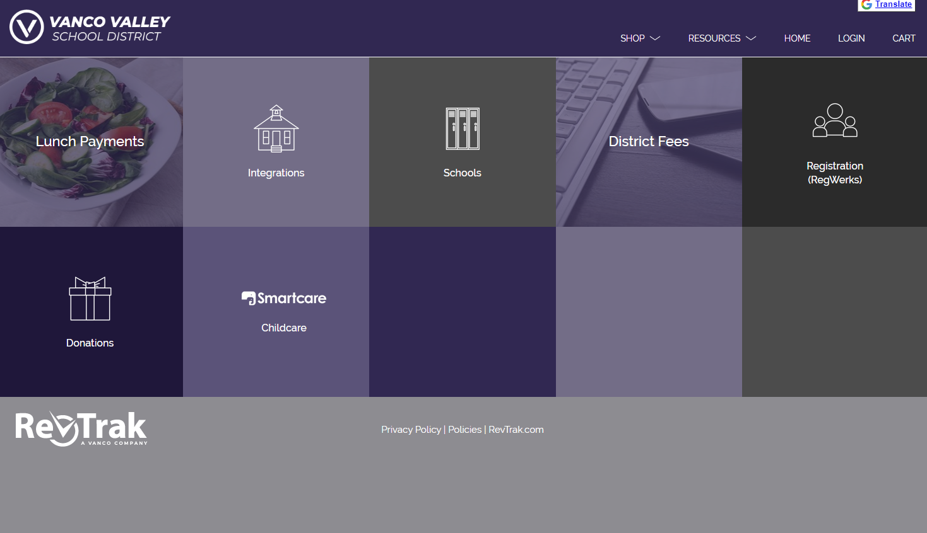
Let’s take a look at the rest of these
helpful RevTrak reports

Slide 11
RevTrak can help you save even more time by guiding your district through these common challenges
Challenge #1: Not enough parents are paying fees in the Web Store.
  Check out our Parent Communication Kit here to help get the word out about your Web Store.
Challenge #2: Not all items have been added to the Web Store.
  Need help getting your Web Store up to date? Check out our self-serve training guide here or get in touch with our Client Support team here.
Challenge #3: I need more training on the new features.
  You came to the right place! We host monthly training webinars for our clients. You can visit our archive of training sessions here or connect with our Client Support team here. Or, revisit Reconciliation Training Guides here

Slide 12
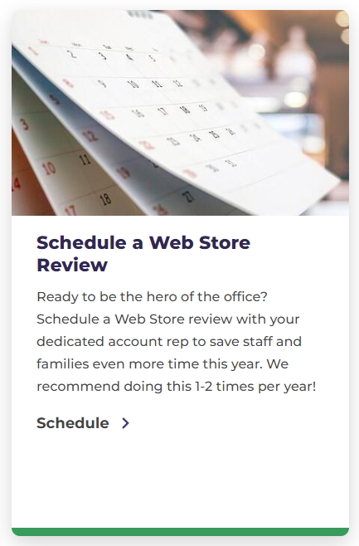
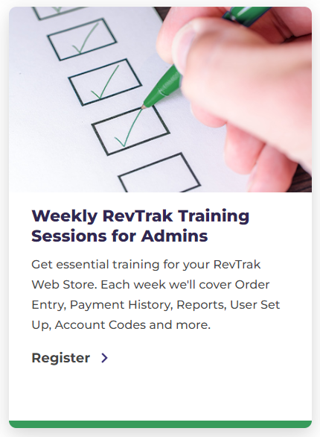
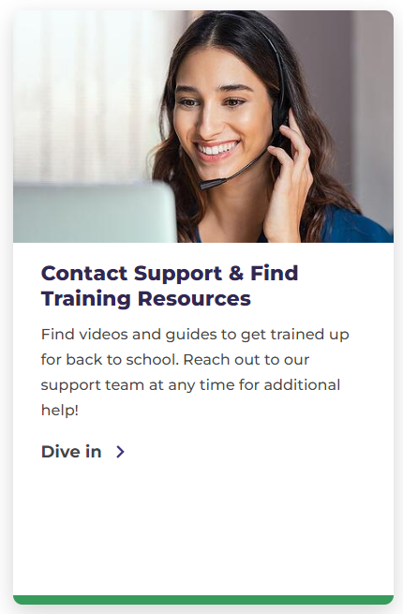
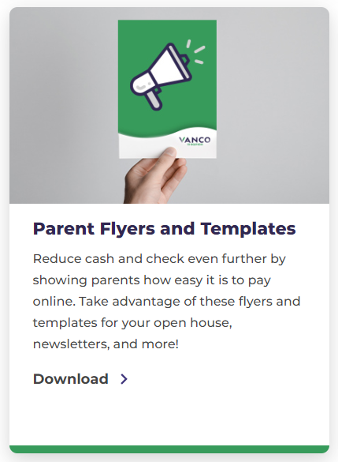
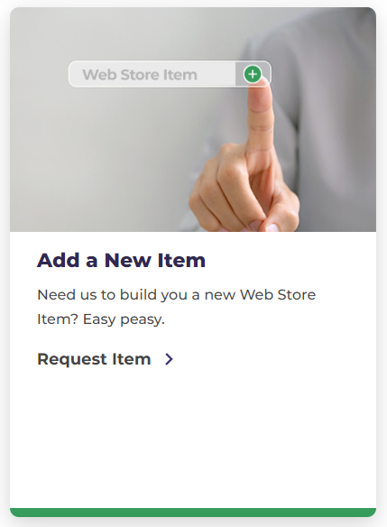
RevTrak Steps for Success
Find all these resources and more at https://www.vancopayments.com/education/client-resources

Slide 13
Other Resources to Ensure a Smooth Fall Semester
Revisit Reconciliation Training Guides here
Help parents get comfortable with online payments
Build a larger and more connected fan base this football season
Check out our other training resources to revisit what we’ve reviewed with you today and more with this link
Notes:
‘Reconciliation’ under ‘Reports’

Slide 14
[Poll]
How can we help you this year?
Notes:
I’d like to schedule a Web Store Review
I’m in need of technical support
I’d like more information about simplifying reconciliation
I’d like more information about using fee management
I’d like more information about selling tickets online
I’d like to do even more with an online store

Slide 15
Thank You!
Additional questions? Reach out to us at:
support@revtrak.zendesk.com
888.847.9885
Notes:
When do more districts set up their web store for fall?

Slide 16
[Survey] We want to hear from you! What would you like to learn more about?

Slide 17
Thank you!

